Slide 1
Introduction to nematic liquid crystals
Lucas Myers

Slide 2
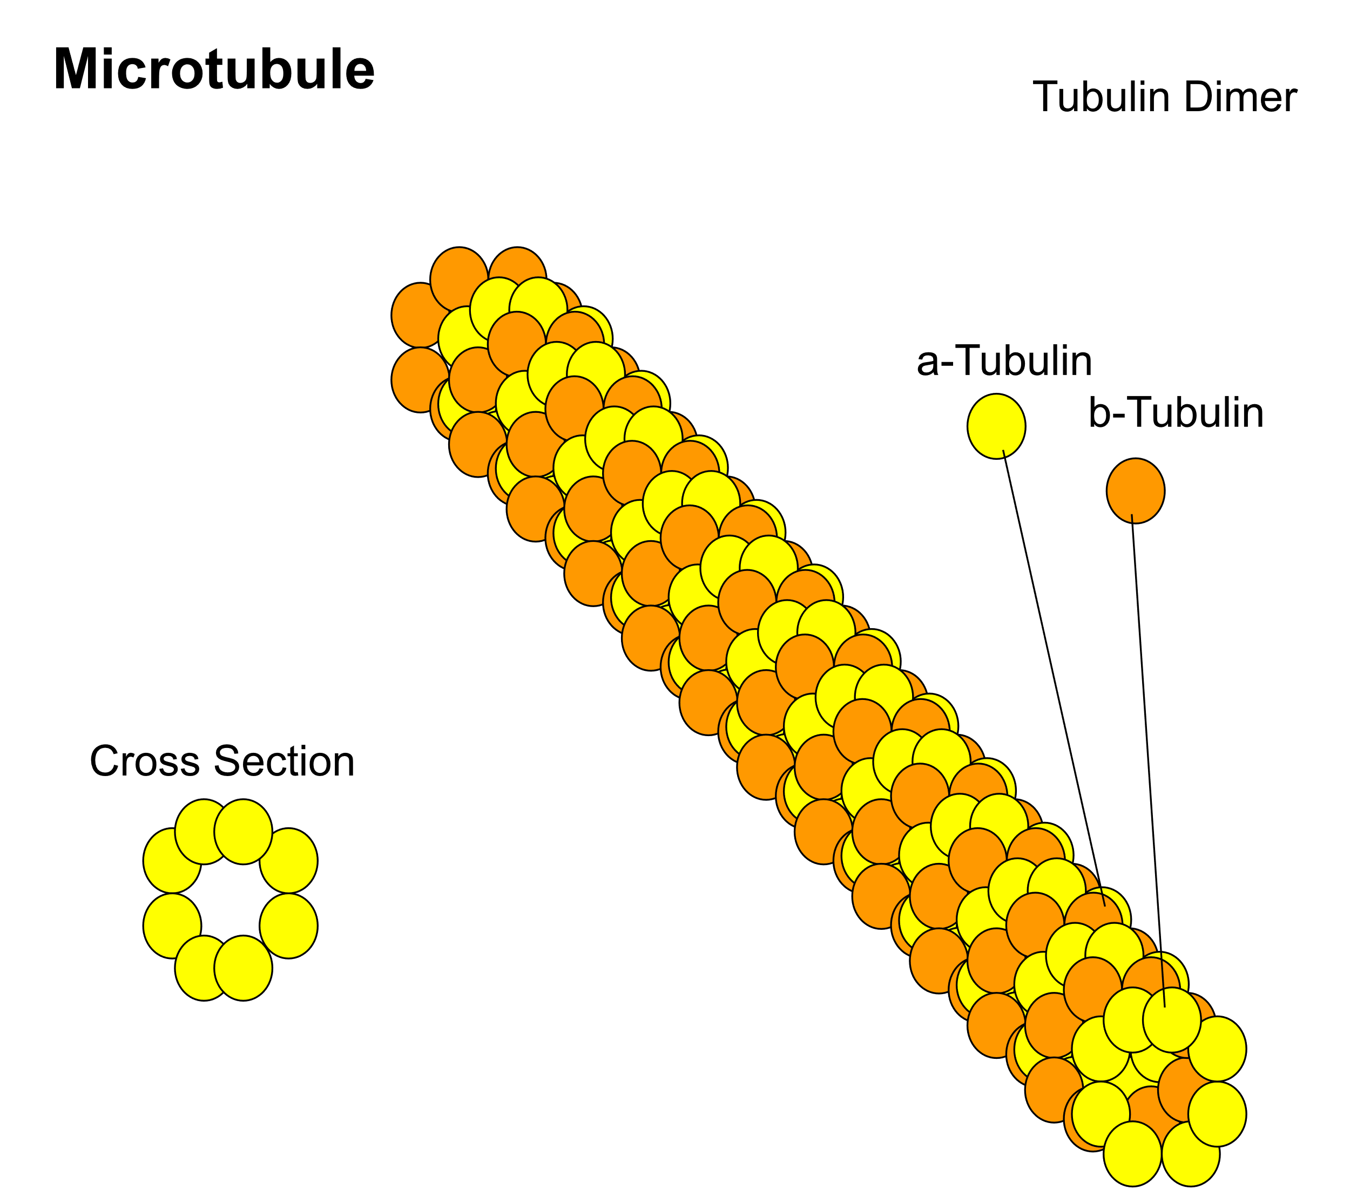
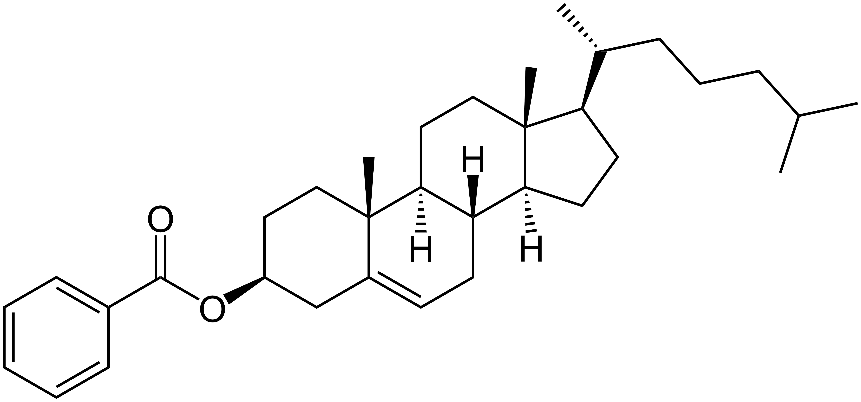
What are liquid crystals?
Any system with rod-like particles which have orientational order, but no positional order
Wikimedia commons

Slide 3
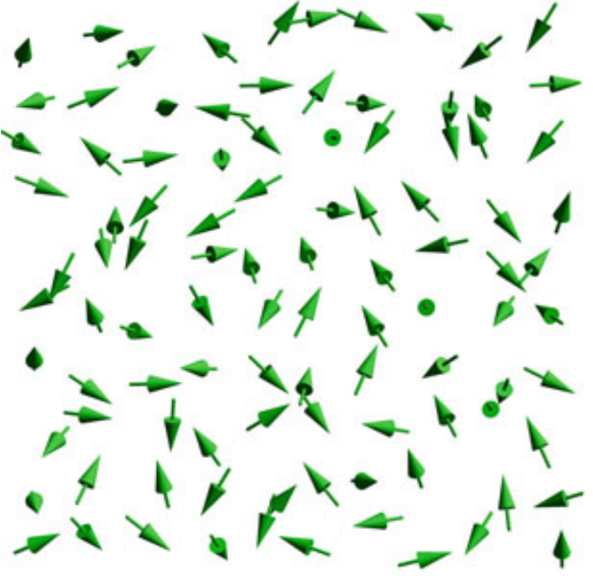
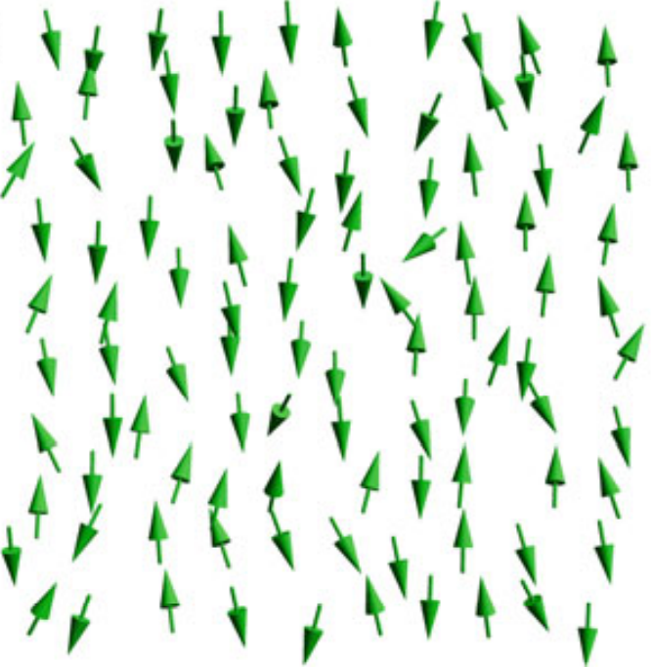
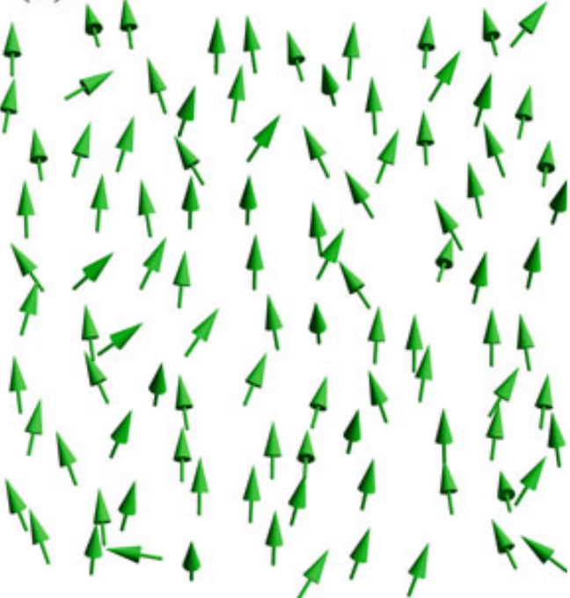
What do the phases look like?
isotropic
nematic
polar
Selinger, Introduction to Soft Matter

Slide 4
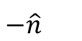
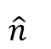
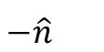
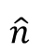
Want to differentiate phases using an average
Can’t just average direction vectors
$$\hat{n}$$
$$\hat{n}$$
$$−\hat{n}$$
$$−\hat{n}$$

Slide 5
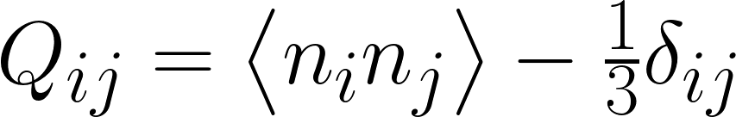
Good average (order parameter) is outer product

Slide 6
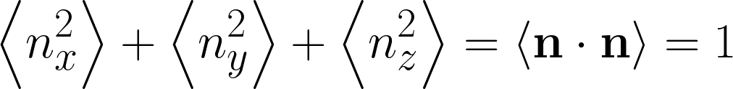
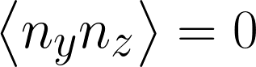
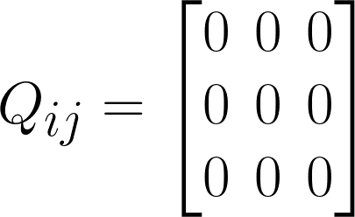
Q for isotropic is zeros

Slide 7
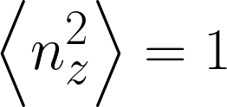
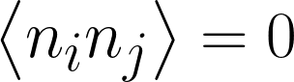
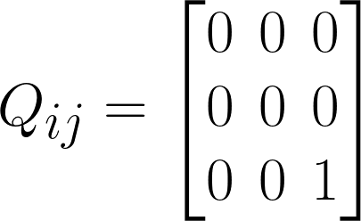
Q for nematic is nonzero
(otherwise)

Slide 8
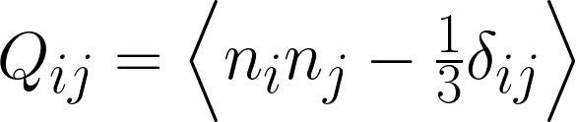
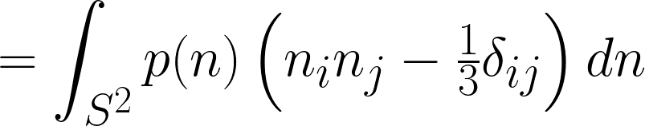
Instead of discrete molecule directions, can use probability functions on sphere

Slide 9
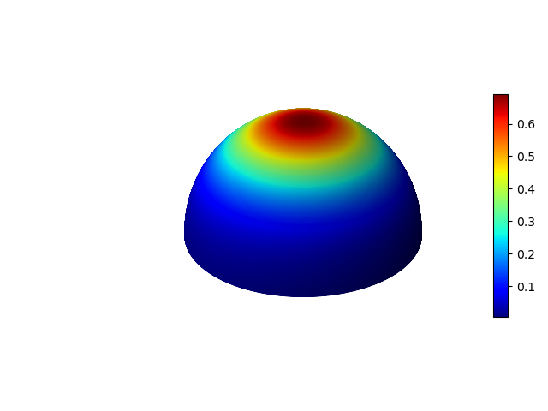
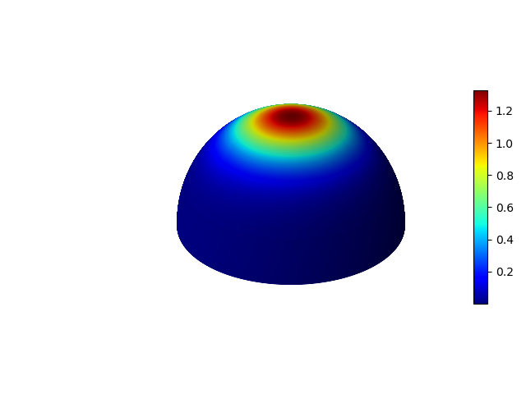
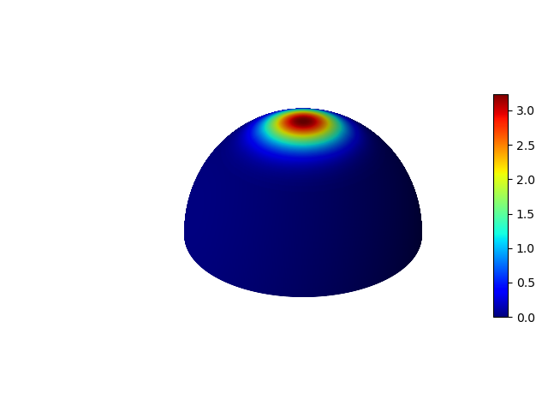
S – proportional to largest eigenvalue of Q – describes order
S = 0.86
S = 0.49
S = 0.69

Slide 10
Need free energy to find equilibrium state
Guess free energy is a smooth function
Taylor expand about phase transition (Landau-de Gennes)

Slide 11
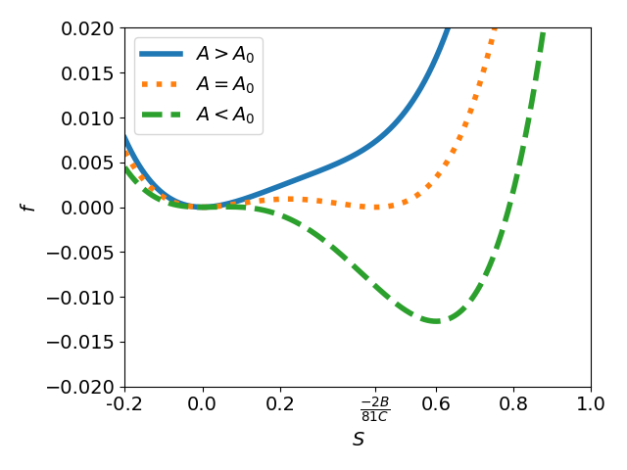
Plot LdG energy vs. S for various A values
Have first order transition at A₀
Take A proportional to T
Low T gives nematic, high T gives isotropic

Slide 12
LdG energy has some problems
Several phenomenological constants
Not based on microscopic structure
Free energy expression does not bound Q – hence, can get unphysical (S > 1) Q
Becomes a problem with non-equilibrium dynamics

Slide 13
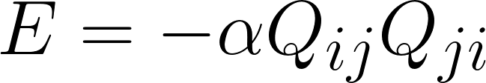
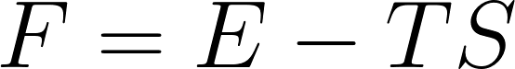
Maier-Saupe energy assumes angle-dependent particle interaction
Expand in spherical harmonics, take mean-field approximation, get:
Free energy given in the usual way:

Slide 14
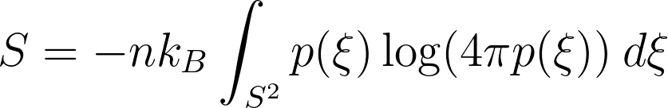
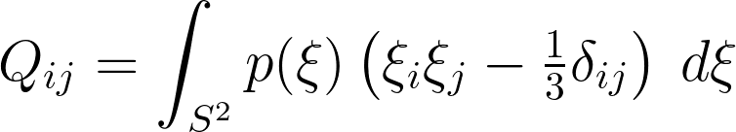
An aside about the Maier-Saupe calculation
S given by:
For fixed Q, need to find p – do this by maximizing S subject to Q constraint:
Turns into variational calculus + Lagrange multiplier problem

Slide 15
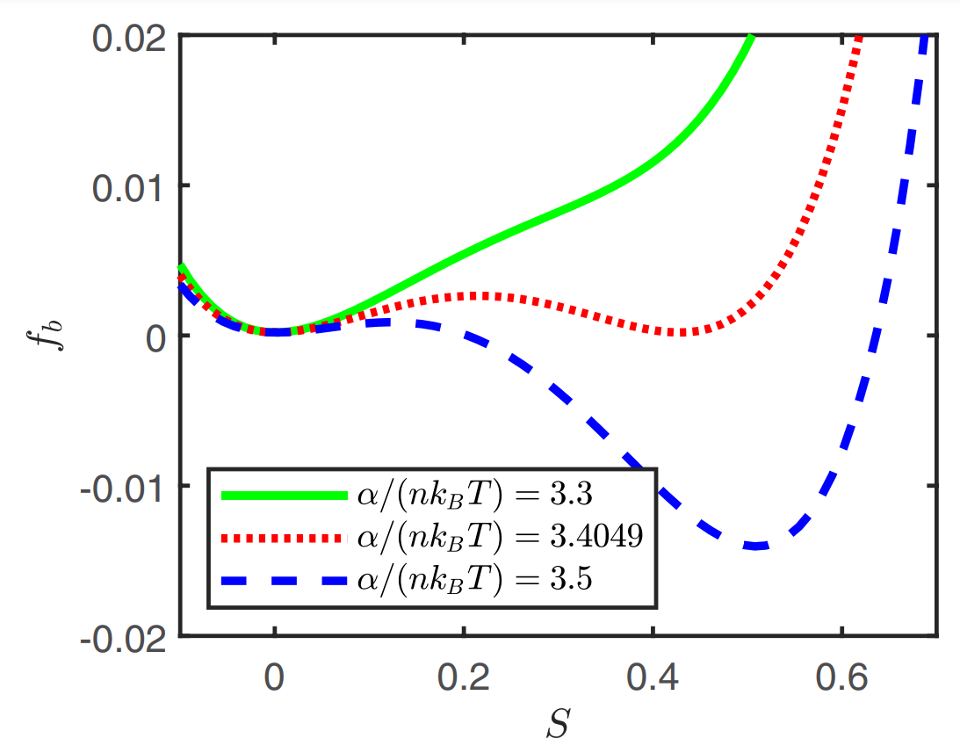
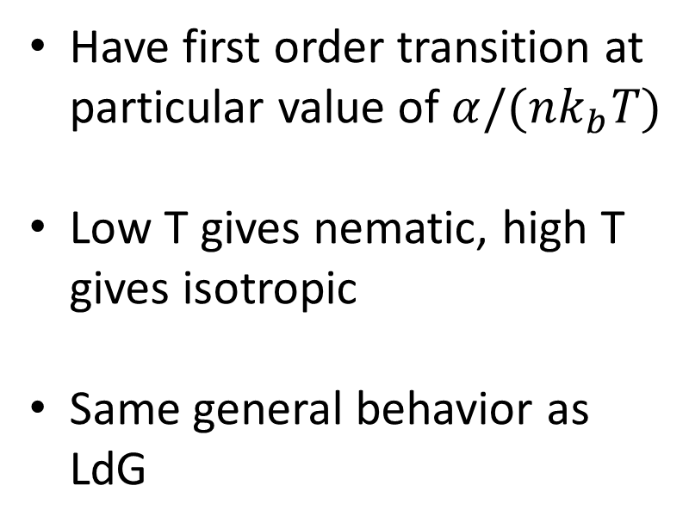
Can plot in terms of physical values + one phenomenological value:
Have first order transition at particular value of $α/(nk_{b}T)$
Low T gives nematic, high T gives isotropic
Same general behavior as LdG
Schimming + Vinals (2020)

Slide 16
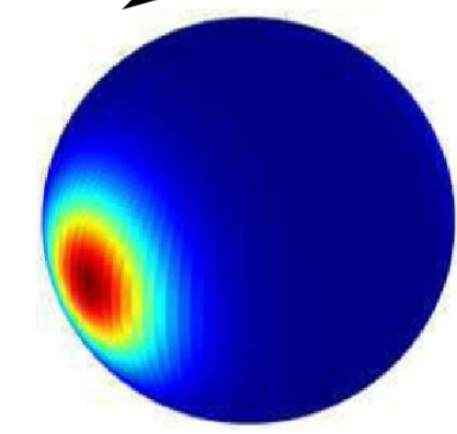
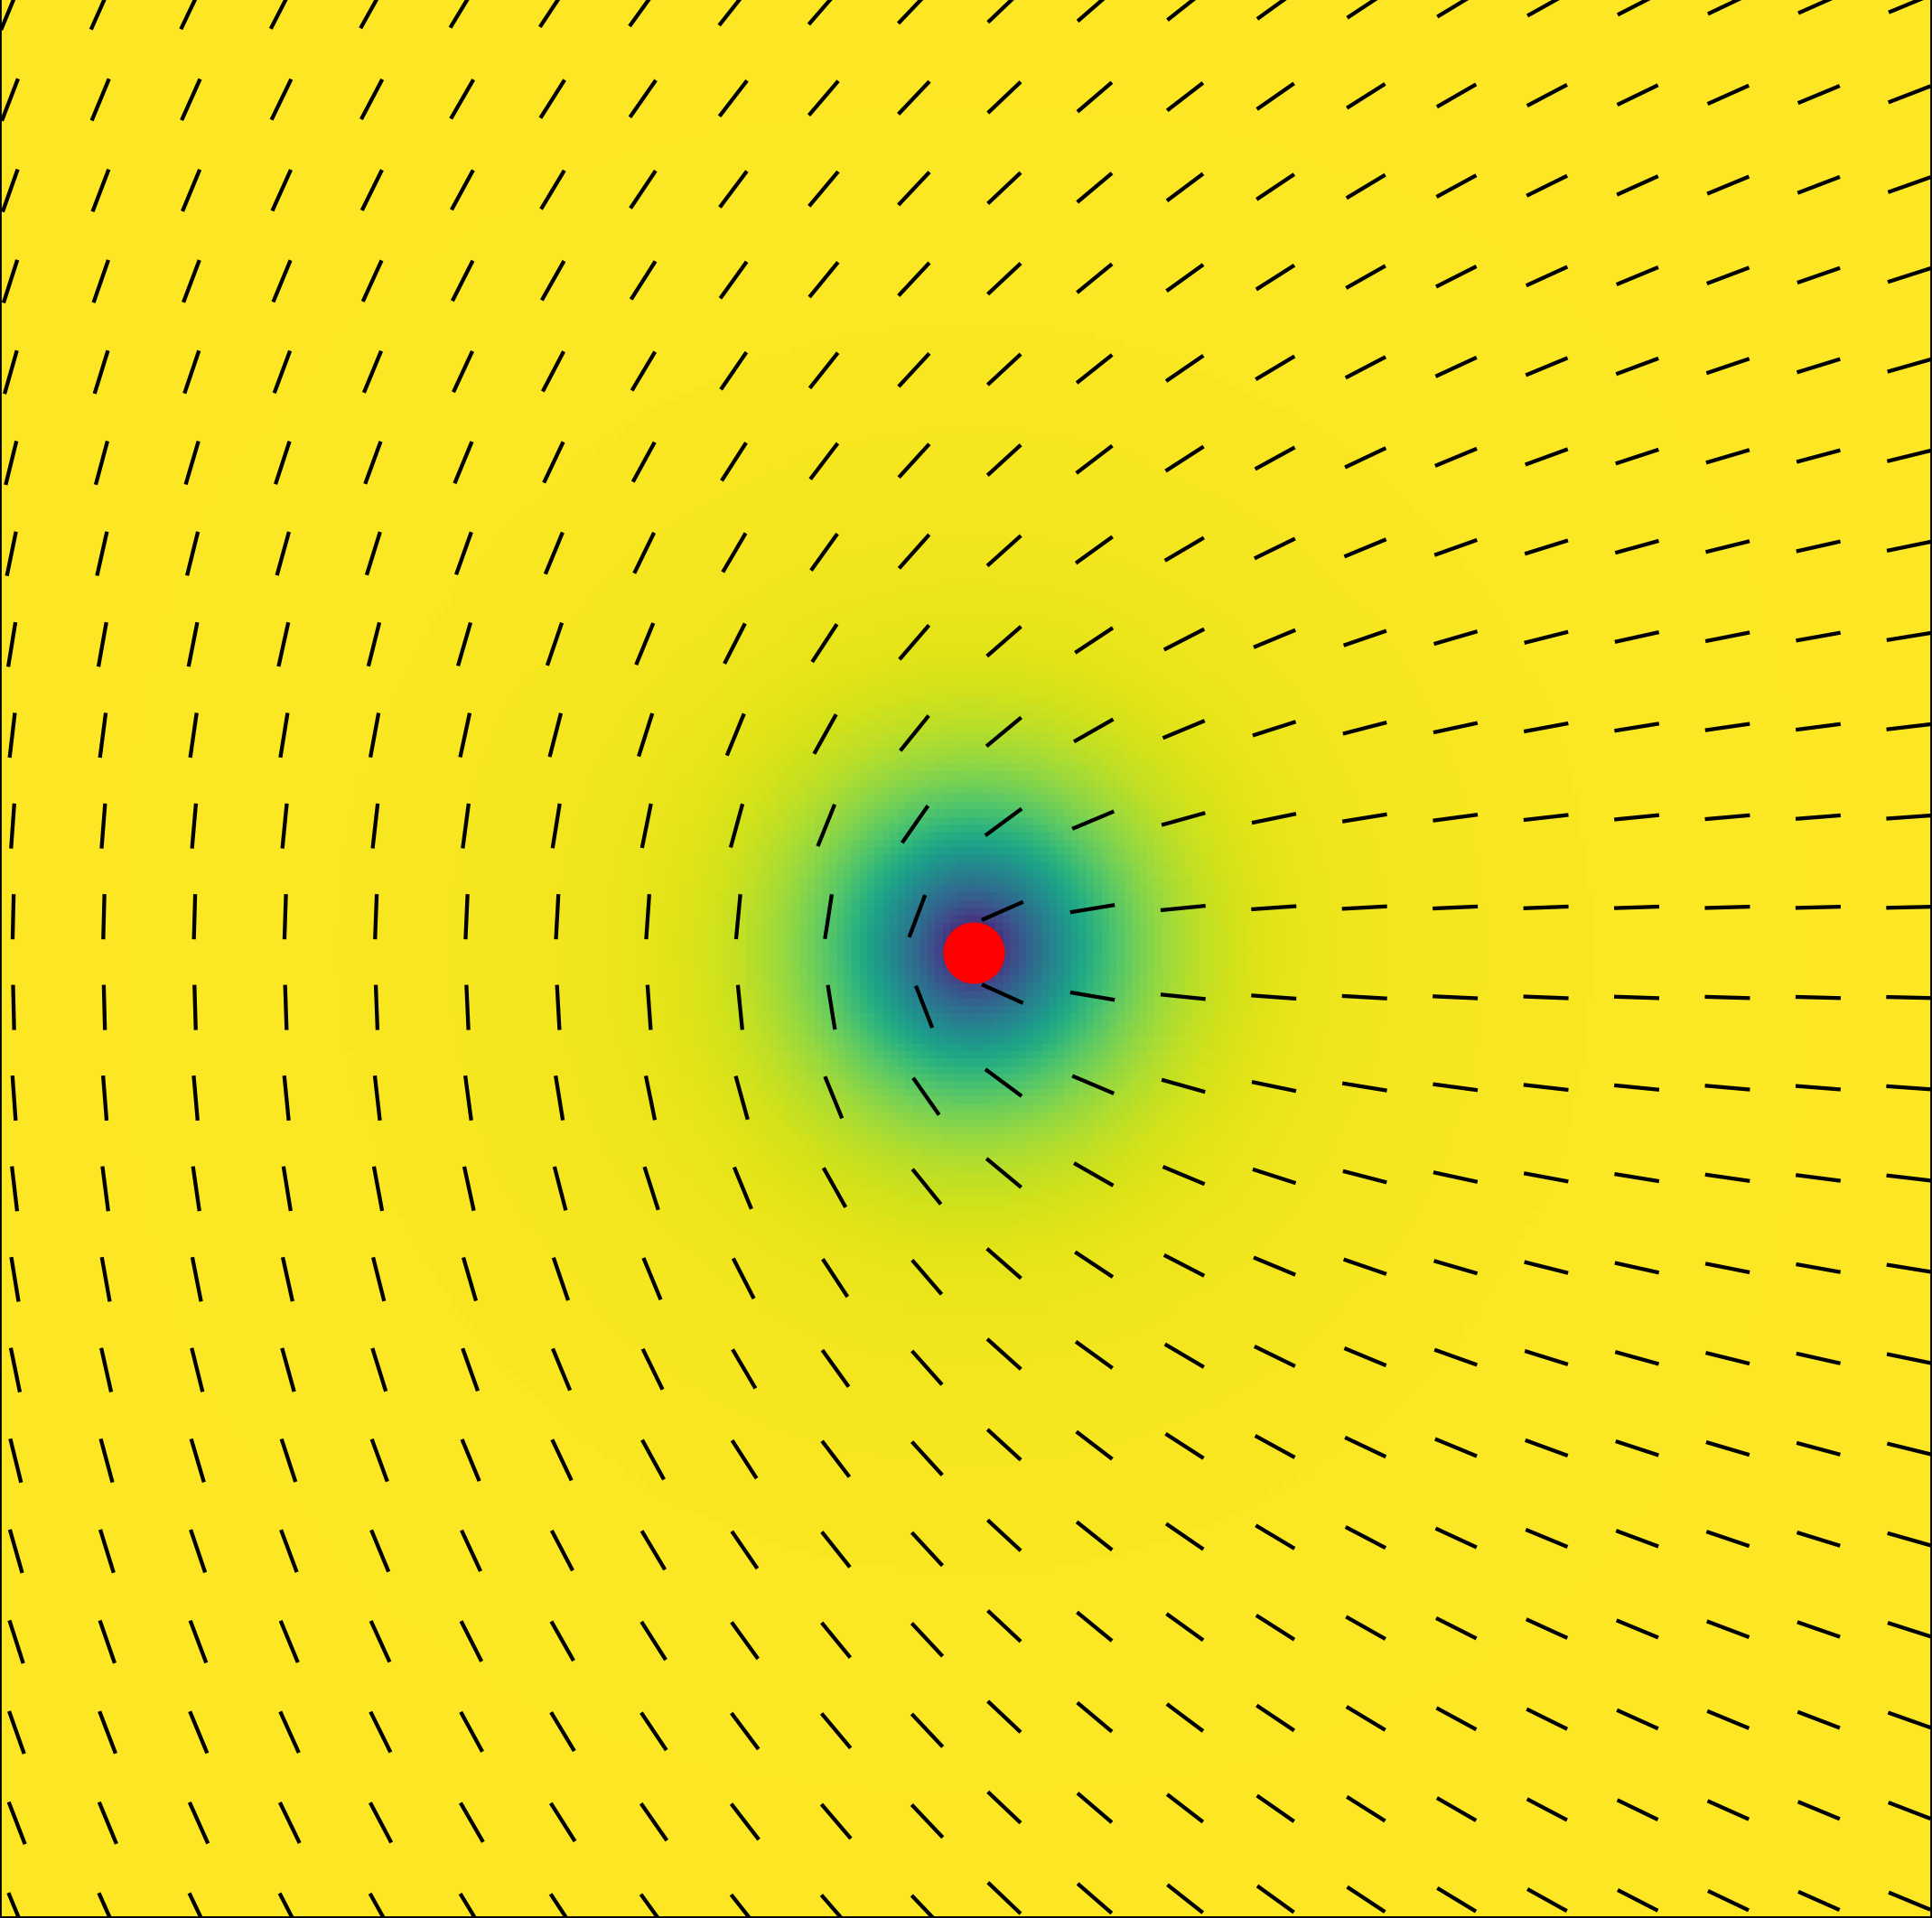
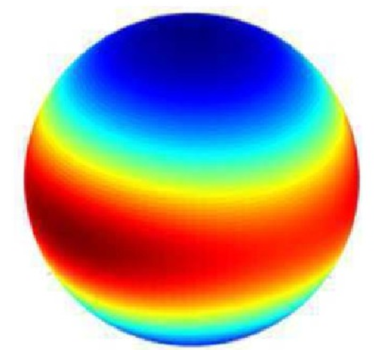
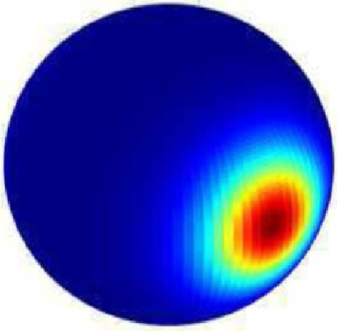
To go to non-equilibrium system, treat small sections as being in local equilibrium
Assign Q to every point
Take energies to be energy densities
Now we have a field theory!
(Need to worry about spatial variations now)
Cody, Vinals, Walker (2021)

Slide 17
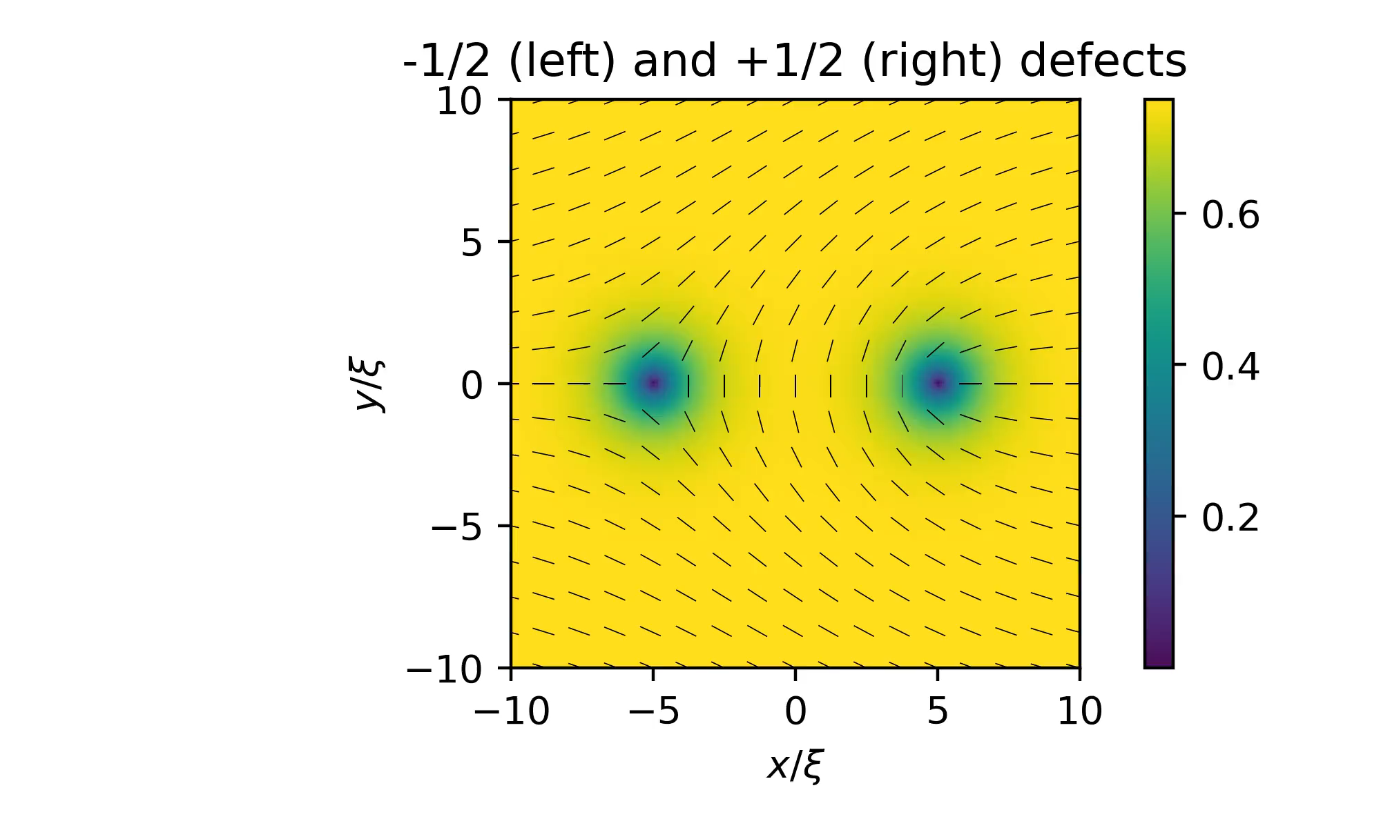
Now we can look at dynamics + emergent properties!
S value

Slide 18
Thanks + Questions

Slide 19
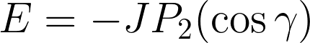
On Maier-Saupe Energy
Guess we have an angle-dependent interaction, expand in spherical harmonics:
Average over all neighboring interactions:
Take mean-field approximation:

